Slide 1


3D Sparse and Different Scale Point Clouds Registration and Robust Estimation of Information Matrix For Pose Graph SLAM
PCR-Pro
IEEE CYBER 2018, July 19-23, Tianjin, China
Paper ID
381
M. Usman Maqbool Bhutta, Ming Liu
M Usman Maqbool Bhutta PhD. Candidate, HKUST

Slide 2
Presentation Plan
1
2
3
Problem Statement
Proposed Method (PCR-Pro)
Introduction
5
4
Conclusion and Future Work
Results and Discussions
An Overview
Notes:
•Lets start from the presentation plan
First I’ll start from introduction of Pose graph SLAM system including multi-agent
Problem statements
At 3, I’ll present you the Proposed Algorithm
Then we will move towards …. Testing and results section,
I will end this by conclusion and future work. I’ll spare some this for questions and answers

Slide 3


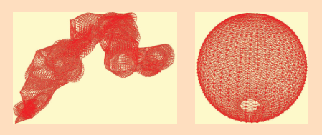
Introduction | PCR-Pro
Non Linear Pose Graph Optimization
Graph-based SLAM [1] methods have undergone a renaissance.
State-of-the-art techniques with respect to speed and accuracy.
Used as a building blocks of more sophisticated methods.
g²o [2] – A general framework for graph optimization.
Fig 1:- Left, Initial configuration. Right, After optimizing the pose graph the sphere [1]
[1] Giorgio Grisetti, R Kummerle, Cyrill Stachniss, and Wolfram Burgard. A Tutorial on Graph-Based SLAM. IEEE Intell. Transp. Syst. Mag., 2(4):31–43, 2010 [2] Rainer Kummerle, Giorgio Grisetti, Hauke Strasdat, Kurt Konolige, and Wolfram Burgard. G2o: A general framework for graph optimization. In 2011 IEEE Int. Conf. Robot. Autom., pages 3607–3613. IEEE, May 2011.
M Usman Maqbool Bhutta | usmanmaqbool.github.io | mumbhutta@connect.ust.hk
Notes:
2- Currently belongs to state of the art techniques
Pose-graph obtained by simulating a robot moving on a sphere.

Slide 4
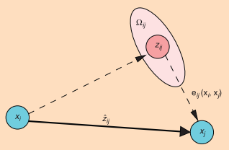
Introduction | PCR-Pro
Non Linear Pose Graph Optimization
In graph-based SLAM, the state variables are the state of the robot and position of the landmarks.
These parameters can be estimated with the sensors of the robot.
The measurement of state variables depends only on the relative poses of the robots.
Fig:2 Aspects of an edge connecting the vertex x_{i} and the vertex x_{j}
[1] Giorgio Grisetti, R Kummerle, Cyrill Stachniss, and Wolfram Burgard. A Tutorial on Graph-Based SLAM. IEEE Intell. Transp. Syst. Mag., 2(4):31–43, 2010 [2] Rainer Kummerle, Giorgio Grisetti, Hauke Strasdat, Kurt Konolige, and Wolfram Burgard. G2o: A general framework for graph optimization. In 2011 IEEE Int. Conf. Robot. Autom., pages 3607–3613. IEEE, May 2011.
M Usman Maqbool Bhutta | usmanmaqbool.github.io | mumbhutta@connect.ust.hk
Notes:
- An edge is fully characterized by its error function e_{ij}(x_{i},x_{j}) and by the information matrix Omega_{ij} of the measurement that accounts for its uncertainty.
edge originates from the measurement z_{ij}
- error e_{ij}(xi, xj) depends on the displacement between the expected and the real measurement.
- Therefore, the measurement of state variables depends only on the relative poses of the robots.

Slide 5

Problem Statement | PCR-Pro
Multi-Agent SLAM
x_{n}
x₂
x₁
X_{n-1}
x_{i}
y₂
y₁
y_{n}
y_{j}
y_{n-1}
Fig:3 Multi-agent SLAM Scenario
M Usman Maqbool Bhutta | usmanmaqbool.github.io | mumbhutta@connect.ust.hk

Slide 6
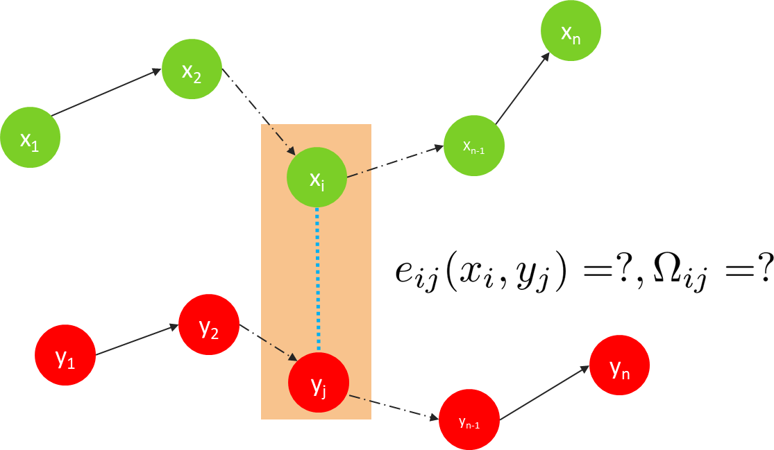
Problem Statement | PCR-Pro
Edge information and Information Matrix
Without any external sensors.
Scale difference when two or more graphs are totally separated and have been created by different cameras [3].
Current ICP techniques are not sufficient.
Multi-agent SLAM is the next interest for computer vision researchers.
Fig:3 Multi-agent SLAM Scenario
[3] Jakob Engel, Thomas Schops, and Daniel Cremers. LSD-SLAM: Large-Scale Direct monocular SLAM, volume 8690 LNCS, pages 834– 849. Springer International Publishing, Cham, 2014.
M Usman Maqbool Bhutta | usmanmaqbool.github.io | mumbhutta@connect.ust.hk
Notes:
To find the edge information between two poses without
any external sensors, such as an IMU, or wheels rotatory
information is a challenging task in large-scale 3D mapping.
Another difficult task is to find out the scale difference when
two or more graphs are totally separated and have been
created by different cameras and approaches, as shown in

Slide 7

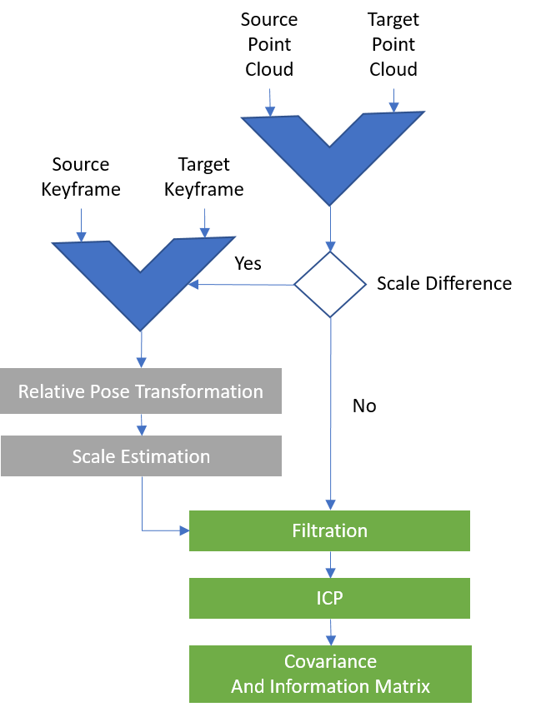
Proposed Approach | PCR-Pro
Overview of the proposed system
Fig 5: Source Point Cloud
Fig 6: Target Point Cloud
M Usman Maqbool Bhutta | usmanmaqbool.github.io | mumbhutta@connect.ust.hk

Slide 8
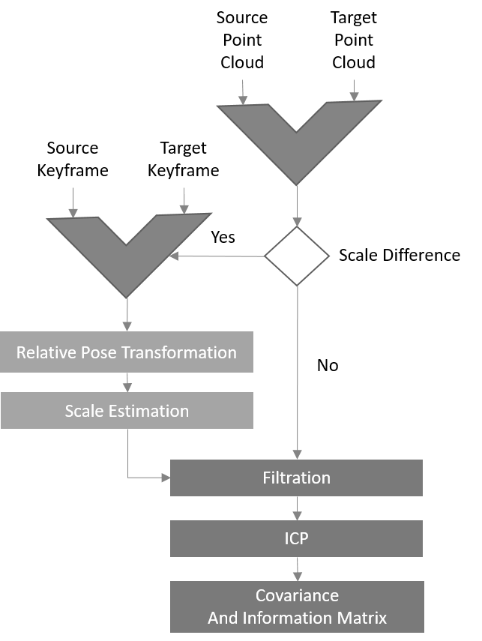
Proposed Approach | PCR-Pro
Overview of the proposed system
Fig 7: Scale Difference
M Usman Maqbool Bhutta | usmanmaqbool.github.io | mumbhutta@connect.ust.hk

Slide 9
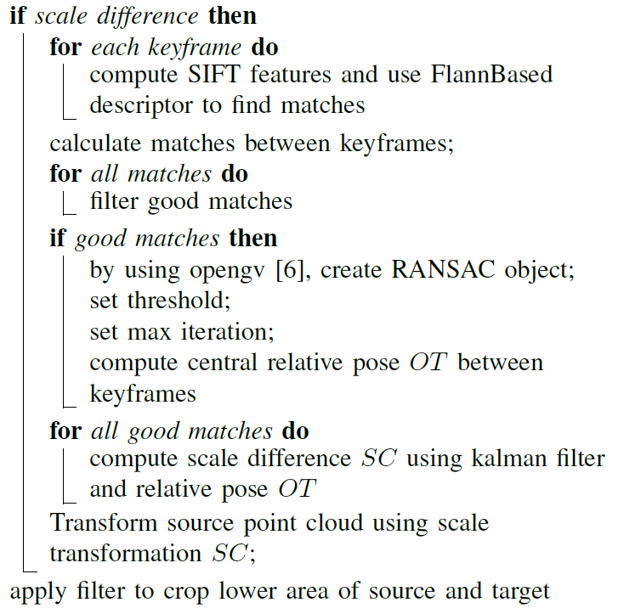

Proposed Approach | PCR-Pro
Scale Estimation
[6] Laurent Kneip and Paul Furgale. OpenGV: A unified and generalized approach to real-time calibrated geometric vision. In 2014 IEEE Int. Conf. Robot. Autom., pages 1–8. IEEE, May 2014.[
M Usman Maqbool Bhutta | usmanmaqbool.github.io | mumbhutta@connect.ust.hk

Slide 10
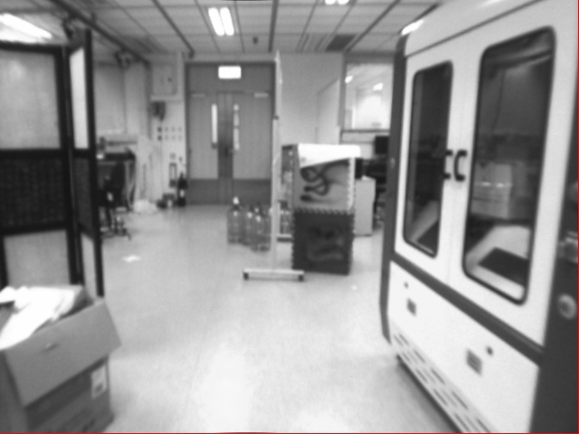
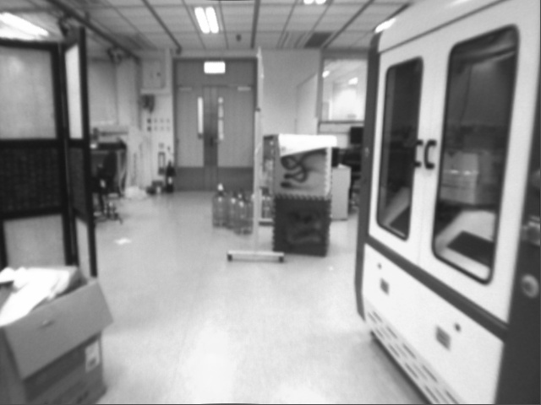
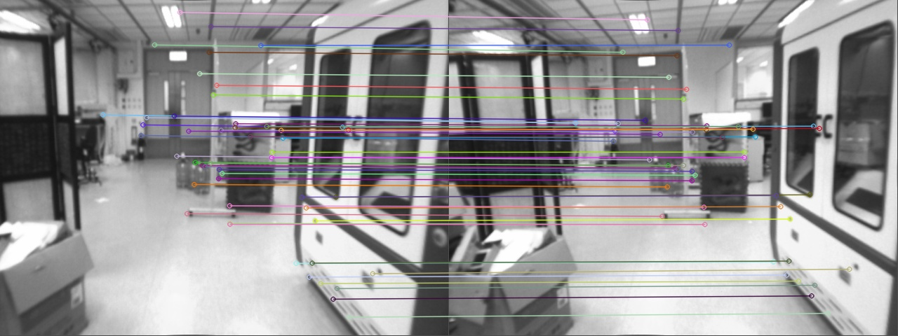
Proposed Approach | PCR-Pro
Scale Estimation
[6] Laurent Kneip and Paul Furgale. OpenGV: A unified and generalized approach to real-time calibrated geometric vision. In 2014 IEEE Int. Conf. Robot. Autom., pages 1–8. IEEE, May 2014.[
M Usman Maqbool Bhutta | usmanmaqbool.github.io | mumbhutta@connect.ust.hk

Slide 11
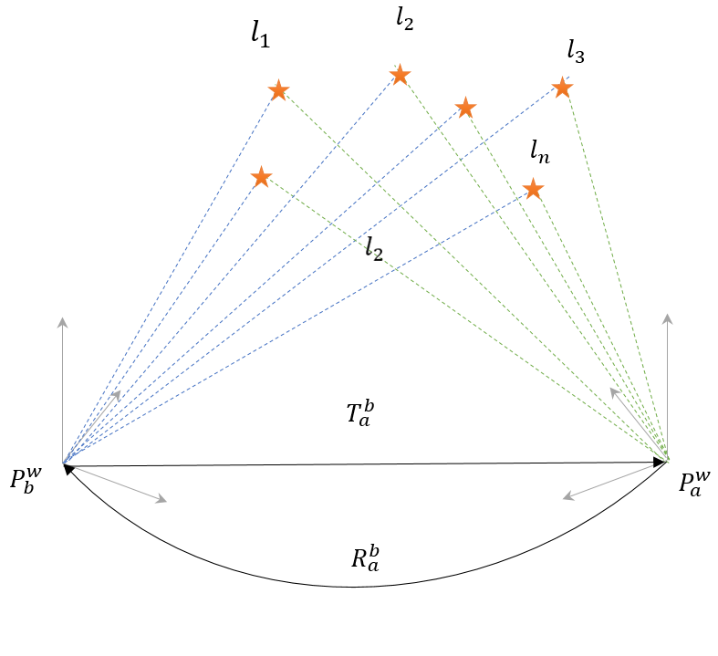
Proposed Approach | PCR-Pro
Scale Estimation
[6] Laurent Kneip and Paul Furgale. OpenGV: A unified and generalized approach to real-time calibrated geometric vision. In 2014 IEEE Int. Conf. Robot. Autom., pages 1–8. IEEE, May 2014.[
M Usman Maqbool Bhutta | usmanmaqbool.github.io | mumbhutta@connect.ust.hk

Slide 12
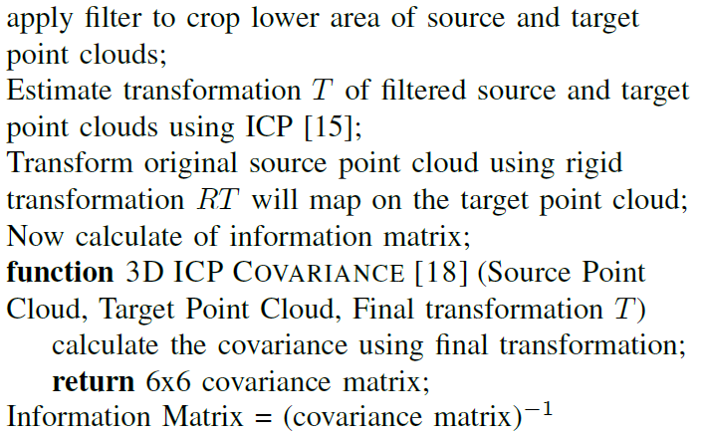
Proposed Approach | PCR-Pro
Transformation and Information Matrix
[15] Franc¸ois Pomerleau, St´ephane Magnenat, Francis Colas, Ming Liu, and Roland Siegwart. Tracking a depth camera: Parameter exploration for fast ICP. In 2011 IEEE/RSJ Int. Conf. Intell. Robot. Syst., pages 3824–3829. IEEE, September 2011 [18] Sai Manoj Prakhya, Liu Bingbing, Yan Rui, and Weisi Lin. A closedform estimate of 3D ICP covariance. In 2015 14th IAPR Int. Conf. Mach. Vis. Appl., number 3, pages 526–529. IEEE, May 2015.
M Usman Maqbool Bhutta | usmanmaqbool.github.io | mumbhutta@connect.ust.hk

Slide 13
Proposed Approach | PCR-Pro
Transformation and Information Matrix
[15] Franc¸ois Pomerleau, St´ephane Magnenat, Francis Colas, Ming Liu, and Roland Siegwart. Tracking a depth camera: Parameter exploration for fast ICP. In 2011 IEEE/RSJ Int. Conf. Intell. Robot. Syst., pages 3824–3829. IEEE, September 2011 [18] Sai Manoj Prakhya, Liu Bingbing, Yan Rui, and Weisi Lin. A closedform estimate of 3D ICP covariance. In 2015 14th IAPR Int. Conf. Mach. Vis. Appl., number 3, pages 526–529. IEEE, May 2015.
M Usman Maqbool Bhutta | usmanmaqbool.github.io | mumbhutta@connect.ust.hk

Slide 14
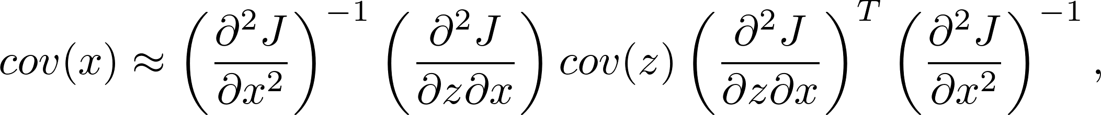
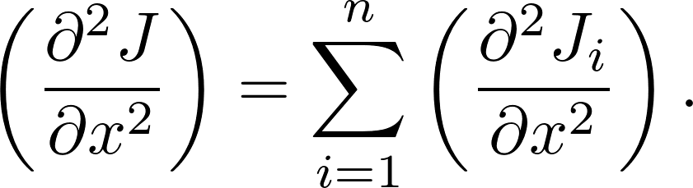
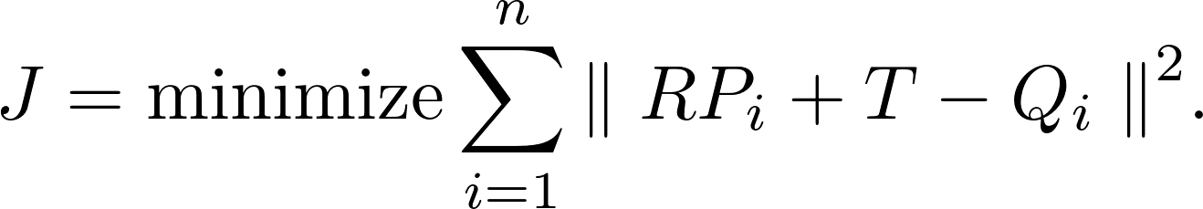
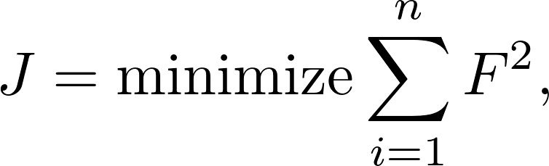
Proposed Approach | PCR-Pro
Transformation and Information Matrix
[3]
(1)
where
[18]
(2)
Where;
[3] Andrea Censi. An accurate closed-form estimate of ICP’s covariance. In Proc. 2007 IEEE Int. Conf. Robot. Autom., pages 3167–3172. IEEE, April 2007.
[15] Franc¸ois Pomerleau, St´ephane Magnenat, Francis Colas, Ming Liu, and Roland Siegwart. Tracking a depth camera: Parameter exploration for fast ICP. In 2011 IEEE/RSJ Int. Conf. Intell. Robot. Syst., pages 3824–3829. IEEE, September 2011 [18] Sai Manoj Prakhya, Liu Bingbing, Yan Rui, and Weisi Lin. A closedform estimate of 3D ICP covariance. In 2015 14th IAPR Int. Conf. Mach. Vis. Appl., number 3, pages 526–529. IEEE, May 2015.
M Usman Maqbool Bhutta | usmanmaqbool.github.io | mumbhutta@connect.ust.hk
Notes:
Our target is to find out the covariance using equation (1), which will use J.
Let z be the input/measurements and x be the output of an algorithm/function that operates on/minimizes an objective function J
This method uses the concept of covariance as constraints that minimize the objective function [2].
The covariance matrix tells us about the covariance between two nodes and is usually, it is calculated from the sensors of robots.
Recently [18] developed a robust estimate of 3D ICP covariance that is a RANSAC-based approach.
We efficiently calculate J using equation (2) and then successfully calculates the covariance matrix of size 6x6.

Slide 15
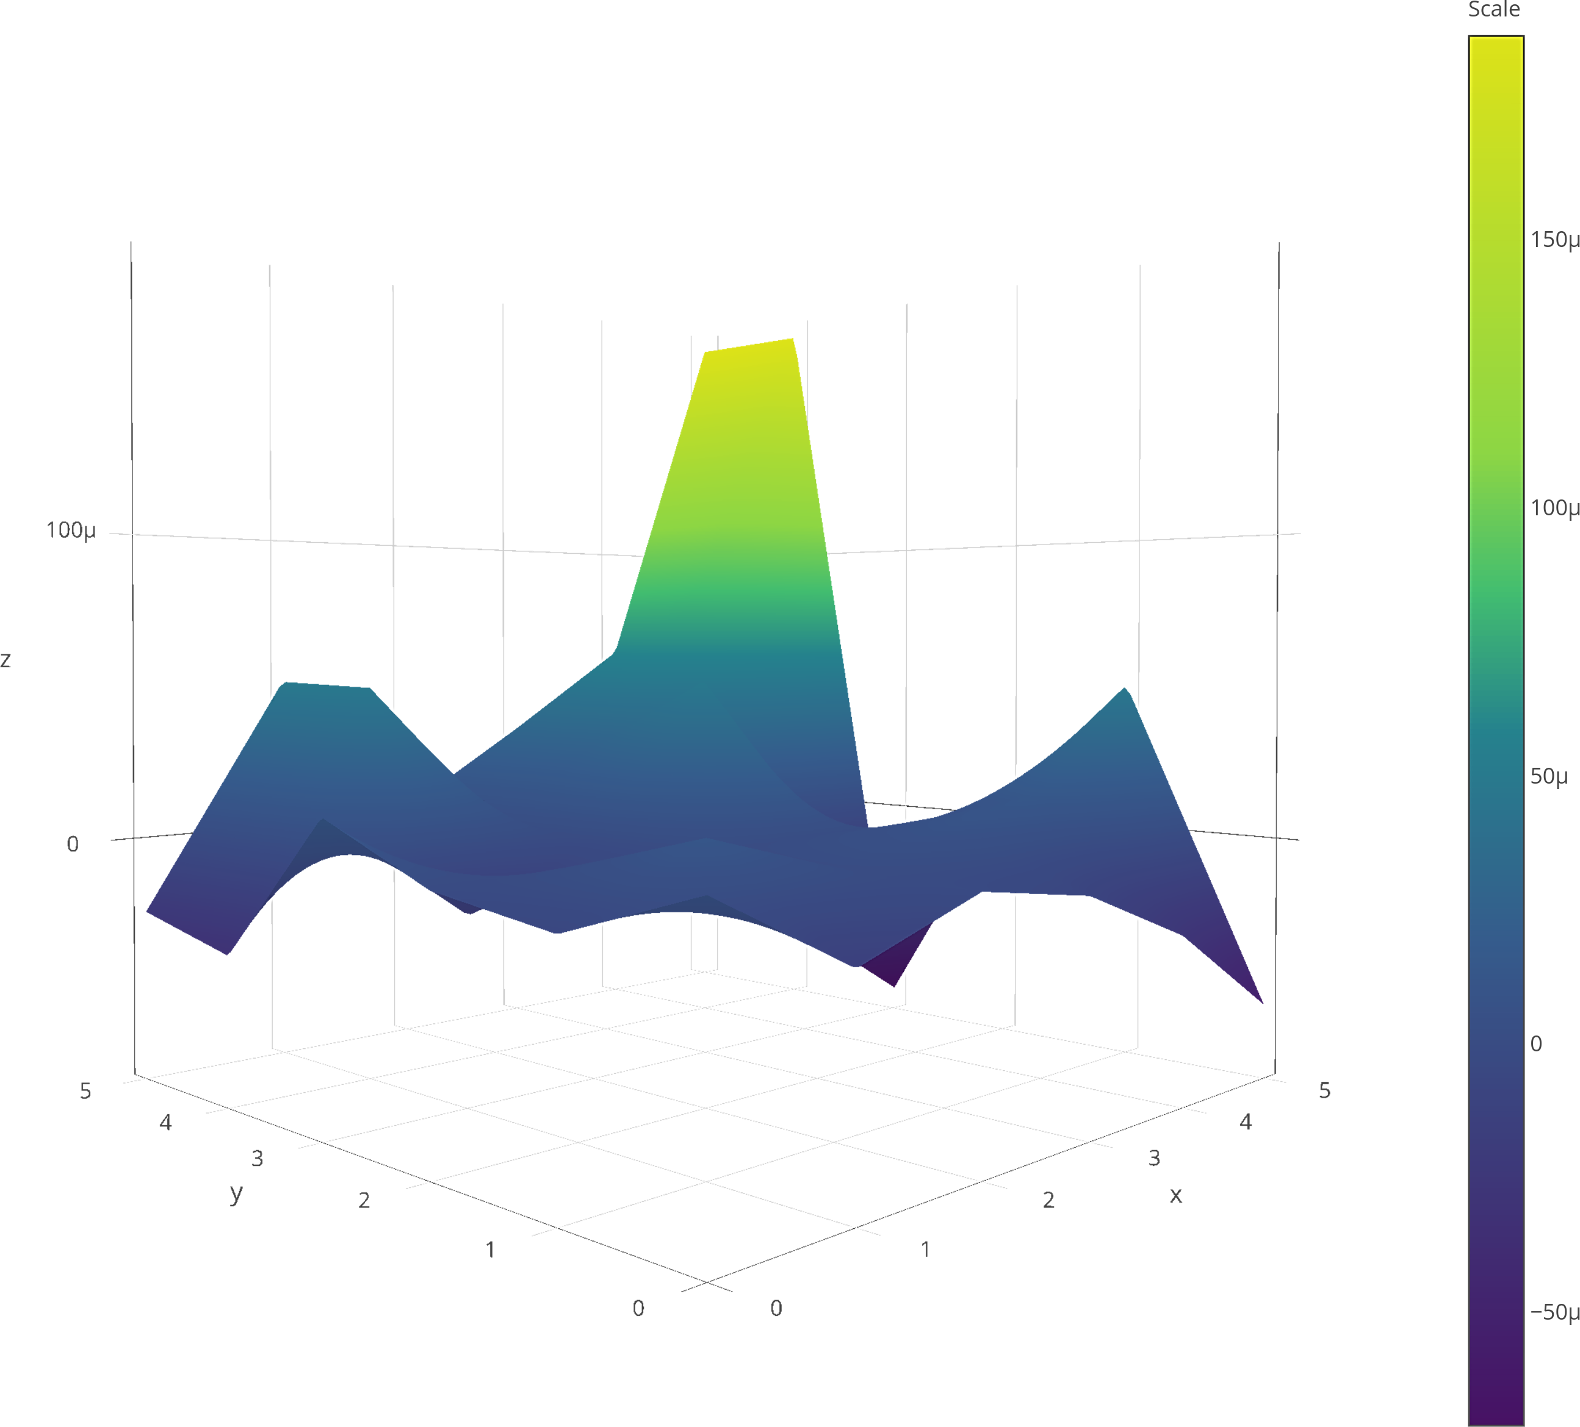
Proposed Approach | PCR-Pro
Transformation and Information Matrix
[15] Franc¸ois Pomerleau, St´ephane Magnenat, Francis Colas, Ming Liu, and Roland Siegwart. Tracking a depth camera: Parameter exploration for fast ICP. In 2011 IEEE/RSJ Int. Conf. Intell. Robot. Syst., pages 3824–3829. IEEE, September 2011 [18] Sai Manoj Prakhya, Liu Bingbing, Yan Rui, and Weisi Lin. A closedform estimate of 3D ICP covariance. In 2015 14th IAPR Int. Conf. Mach. Vis. Appl., number 3, pages 526–529. IEEE, May 2015.
M Usman Maqbool Bhutta | usmanmaqbool.github.io | mumbhutta@connect.ust.hk
Notes:
As the algorithm converges to global minimum, so the resulting covariance is too small. The calculated values
are shown in Fig.
By taking the inverse transform, the information matrix is calculated.

Slide 16


Testing and Results
Results and Discussions| PCR-Pro
Available at YouTube: https://www.youtube.com/watch?v=jVjiV6BOH10
M Usman Maqbool Bhutta | usmanmaqbool.github.io | mumbhutta@connect.ust.hk

Slide 17

Conclusion and Future Work
Conclusion and Future Work| PCR-Pro
PCR-Pro is a robust method to find an accurate transformation between sparse and different scale point clouds.
The covariance is very small as system converges to a global minimum.
Our algorithm works excellently as compared to other ICP algorithms.
We developed an way of using direct SLAM approaches for multi-agent SLAM systems.
Real time multi-agent SLAM systems.
M Usman Maqbool Bhutta | usmanmaqbool.github.io | mumbhutta@connect.ust.hk
Notes:
- The results shows PCR-Pro is a robust method to find an accurate transformation between sparse point clouds where the system converges to a global minimum.
- The covariance is very small, which will help in the usage of the information matrix and will solve many existing problems.
- Our algorithm works excellently as compared to other ICP algorithms, regardless of the sparsity of the point cloud.
- We developed an way of using direct SLAM approaches for multi-agent SLAM systems where we do not have information of the scale difference.
- It welcomes the features data to the featureless SLAM approaches.
- We are working to develop multi-agent SLAM system.
as it is

Slide 18

Any Question
?
M Usman Maqbool Bhutta | usmanmaqbool.github.io | mumbhutta@connect.ust.hk

Slide 19



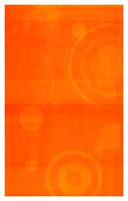

Thank you
Thank you

